Slide 1
Basic principles of visualisations

Slide 2
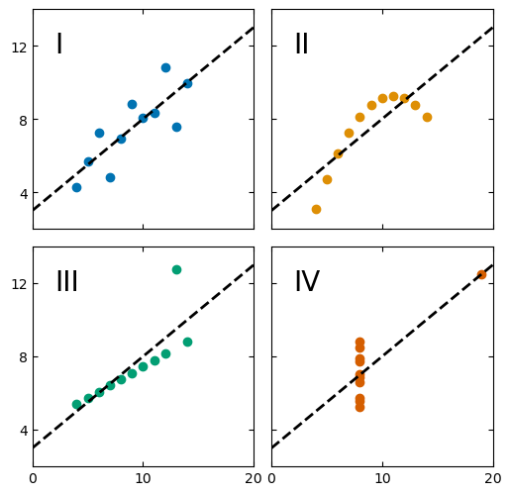
Quiz time!
2 minutes.
For each plot, guess the value of the:
Mean
Correlation coefficient
Notes:
Difficult to easily guess

Slide 3
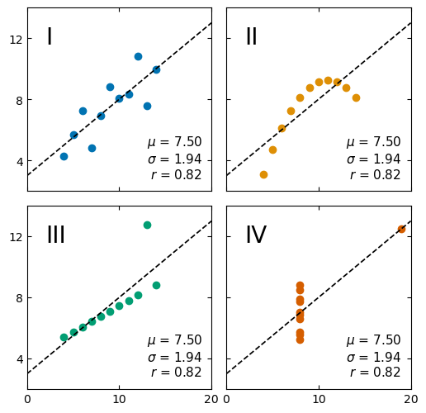
Why do we visualise data?
Graphics go beyond statistical summaries
Data visualisation can be:
Exploratory: to reveal, discover patterns in a dataset
Explanatory: to communicate information concisely to the public, to a journal…
Notes:
Legend helps a lot, you present data to readers so they don’t have to search for it themselves

Slide 4
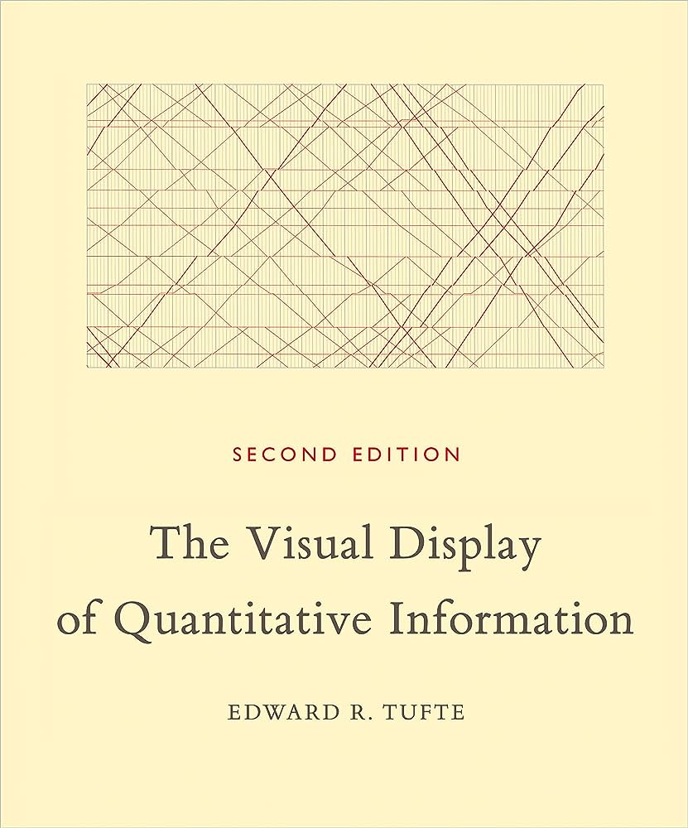
“Graphical excellence”
Graphical excellence = presenting interesting data well
Substance
Statistics
Design
Communicate complex ideas with clarity, precision and efficiency
Giving the greatest number of ideas:
In the shortest time
With the least ink
In the smallest space
Preferring multivariate plots (nearly always)
Telling the truth about the data
Notes:
3 components- substance stats…
For author Definition of data viz- give greatest idea

Slide 5

Good practices for “graphical excellence”

Slide 6
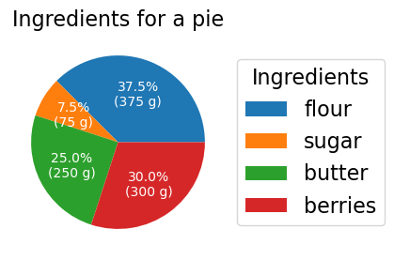
1. Prefer tables to graphics for small datasets
→ Avoid vertical lines
→ Prefer left-aligned text
→ 3 horizontal lines are enough
https://people.inf.ethz.ch/markusp/teaching/guides/guide-tables.pdf
A (useless) pie chart of a pie ☺
 | Quantity (g)
flour | 375
berries | 300
butter | 250
sugar | 75
Notes:
Course about visualising data, but not always the best, sometimes tables do the job just as well

Slide 7
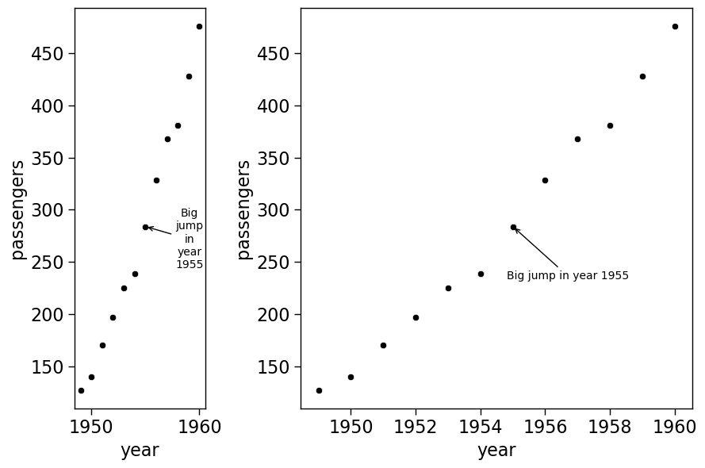
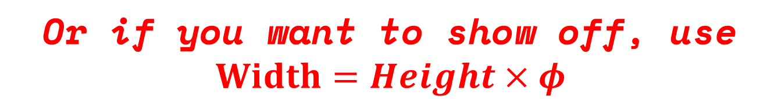

2. Prefer wider graphs
Easier to read time-series or causal data
Easier to label things
Advice from E. Tufte:
$$Width=1.5×Height$$
Or if you want to show off, use
$$Width=Height×φ$$
Notes:
Easier to read
Phi- inverse of golden ratio

Slide 8
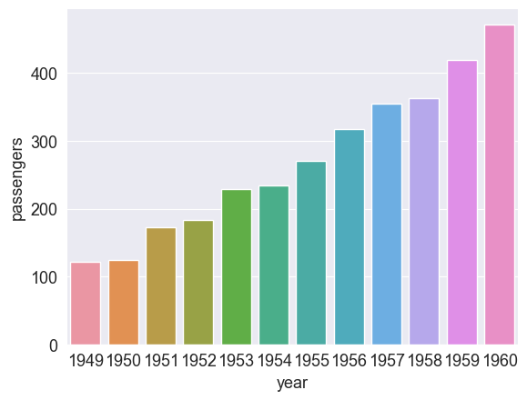
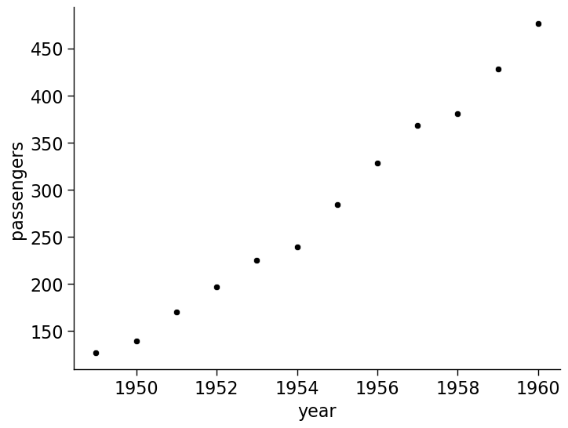
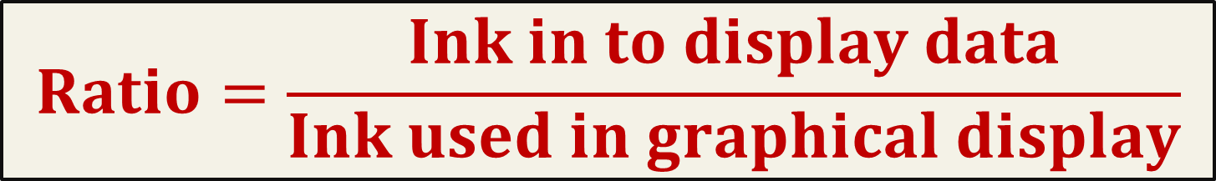
3. Maximise the data-to-ink ratio
$$Ratio=\frac{Ink in to display data}{Ink used in graphical display}$$
Remove background
Change
y-axis
Too many ticks
Useless colours

Slide 9
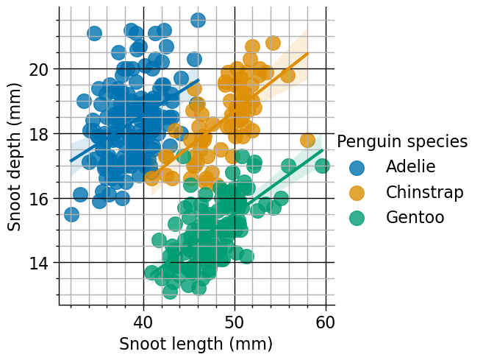
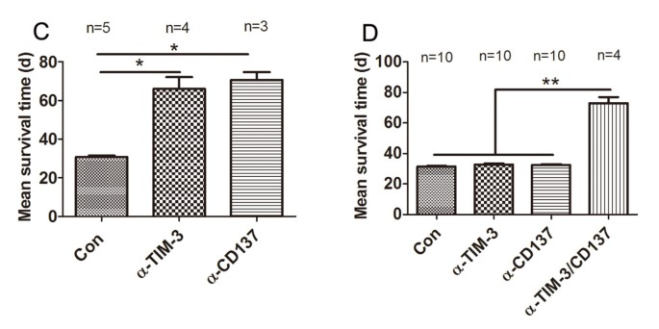
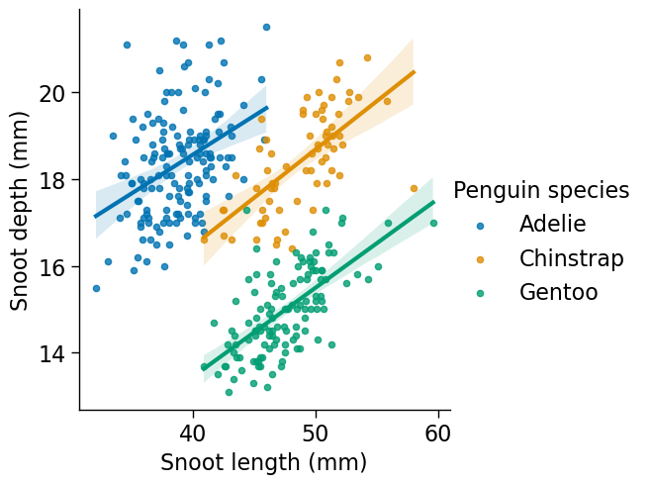
4. Avoid chartjunk
Source: https://doi.org/10.1186/1479-5876-11-215
Notes:
Select your point sizes carefully, prepare your data better
Protein survival- don’t need patterns.

Slide 10
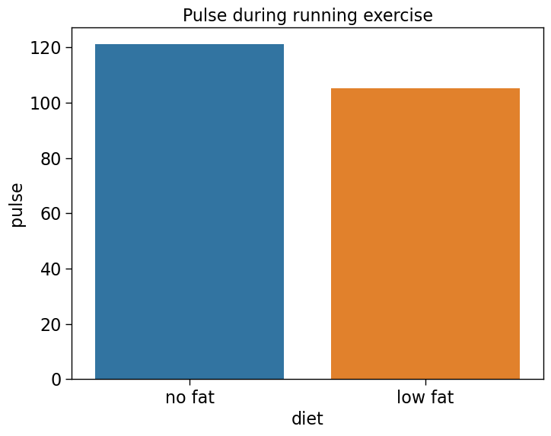
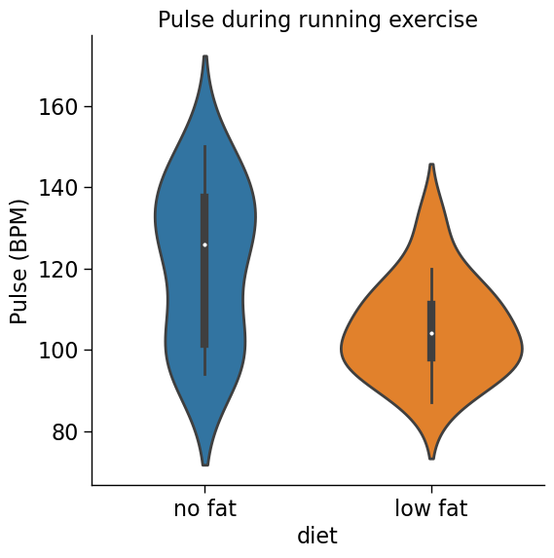
5. Maximise data density = number of entries in a plot
Number of points plotted = ?
Number of points plotted = ?
Source: https://github.com/mwaskom/seaborn-data

Slide 11
5. Maximise data density = number of entries in a plot
Number of points plotted = 2
Number of points plotted = 5 + distribution
Source: https://github.com/mwaskom/seaborn-data

Slide 12
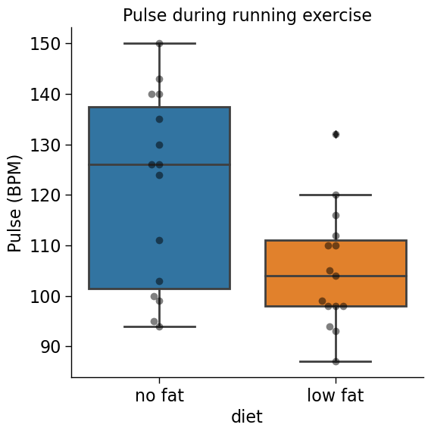
5. Maximise data density = number of entries in a plot
Number of points plotted = 2
Number of points plotted = 40
Source: https://github.com/mwaskom/seaborn-data

Slide 13
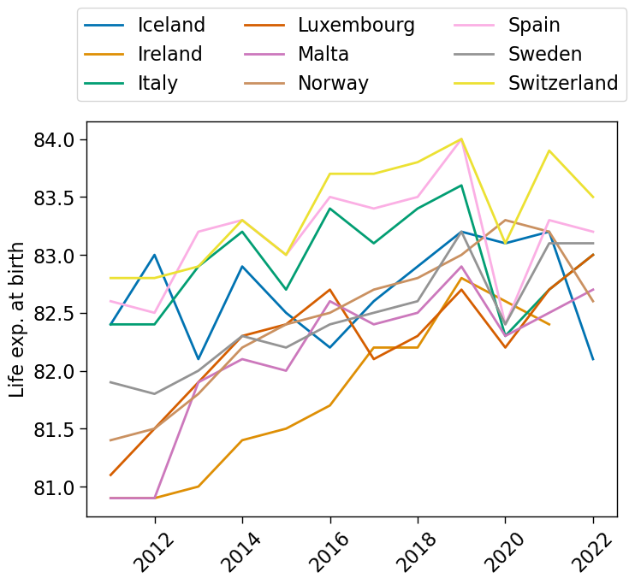
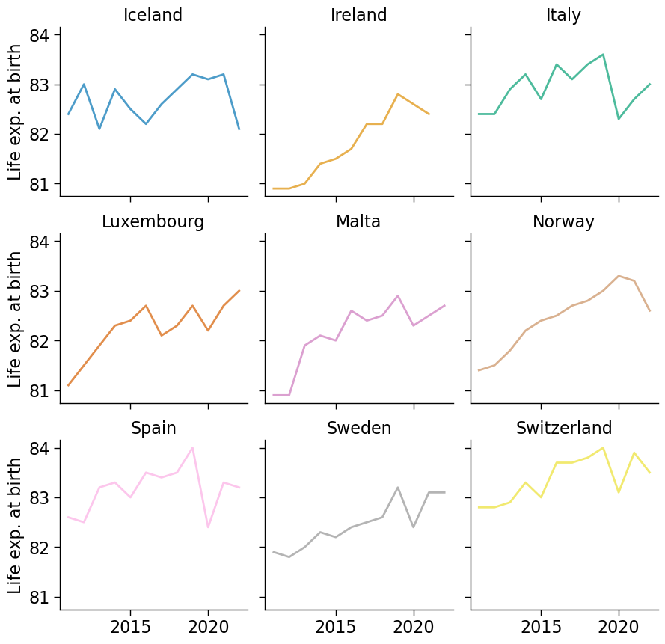
6. Shrink graphics whenever possible: small multiples
Source: https://ec.europa.eu/eurostat/databrowser/view/TPS00205/default/table?lang=en

Slide 14
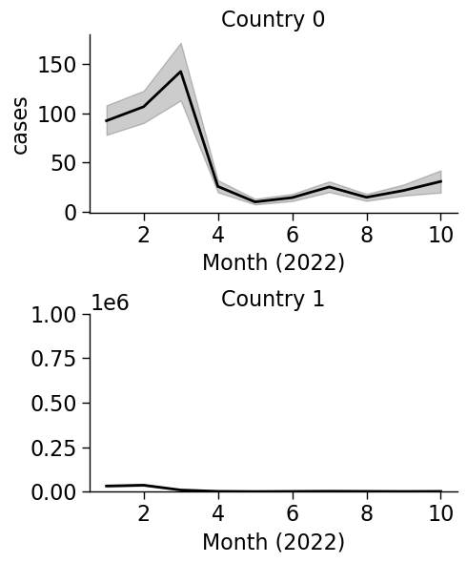
7. Axes: label them consistently, choose them wisely
1 minute: which country has the highest number of COVID cases?

Slide 15
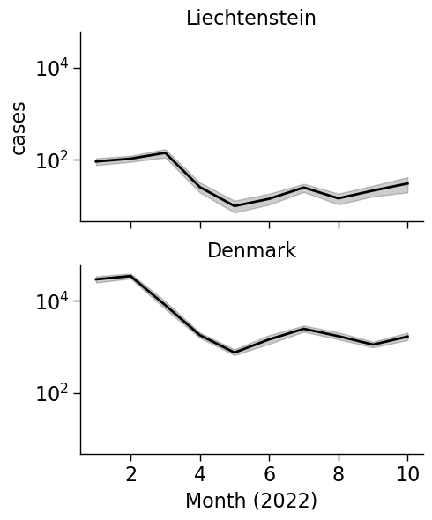
7. Axes: label them consistently, choose them wisely
Use the same scale when comparing subplots = easier comparison

Slide 16
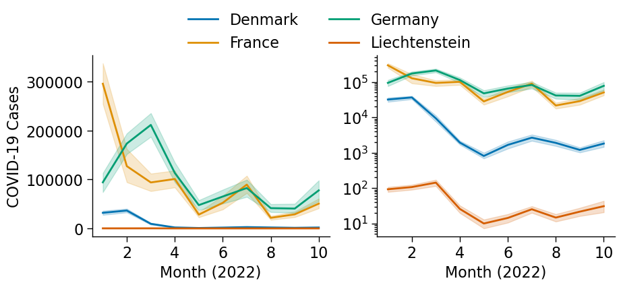
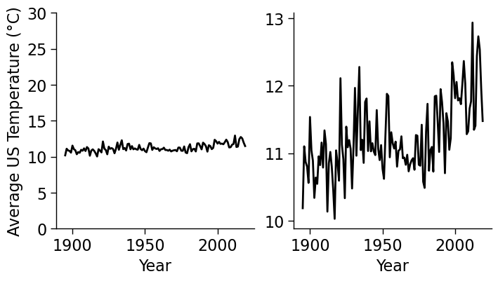
7. Axes: label them consistently, choose them wisely
Inappropriate scaling can hide variations
Use log scales when variation is large
Notes:
Left climate deniers. Right actual

Slide 17
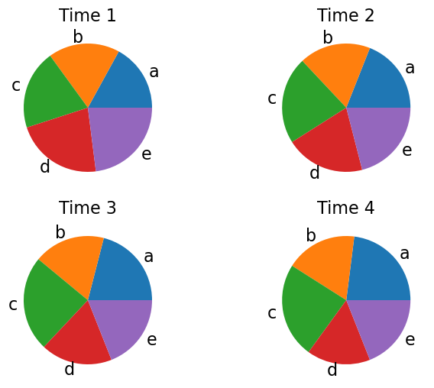
8. Patterns: some are more difficult to compare
Which groups (a, b, c, d, e) increased or decreased from time 1 to 4?
Inspired from: https://www.data-to-viz.com/caveat/pie.html

Slide 18
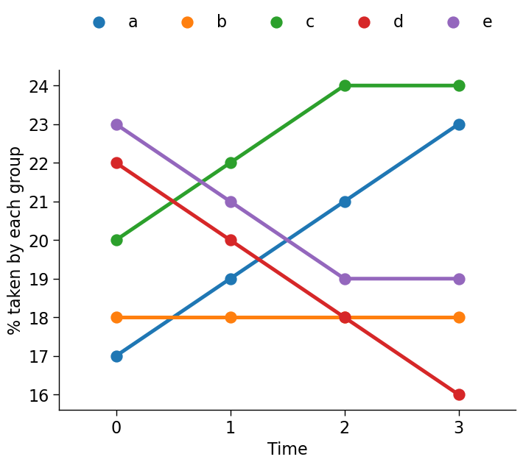
8. Patterns: some are more difficult to compare
Easier to read
Harder to read
Position
Length
Direction
Angle
Area
Volume
Colour
Inspired from: https://www.data-to-viz.com/caveat/pie.html

Slide 19

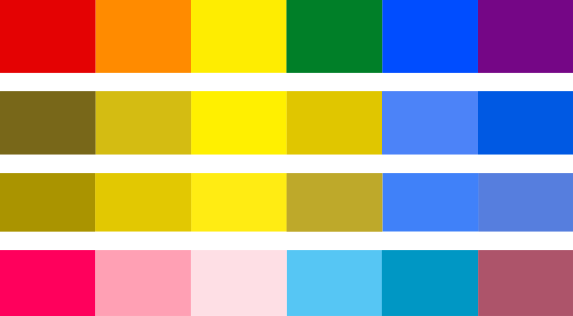

9. Colours: there are palette-able solutions for all eyes
Colour blindness affects:
8% of males
0.5% of females [1]
Alternatives
Using a colourblind-friendly palette
Use high contrast designs
Normal
Protanopia
Deuteranopia
Tritanopia
https://www.nei.nih.gov/learn-about-eye-health/eye-conditions-and-diseases/color-blindness
https://www.color-blindness.com/coblis-color-blindness-simulator/

Slide 20
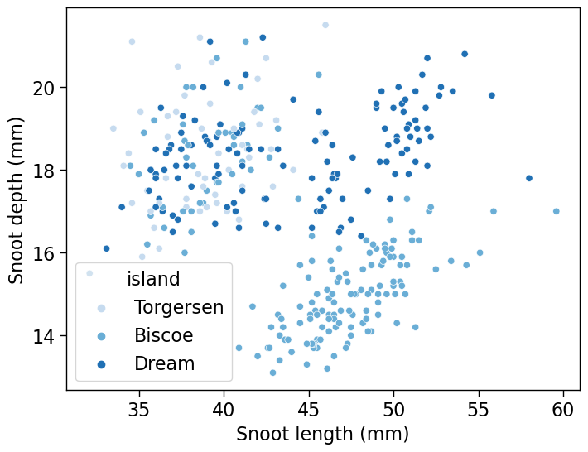
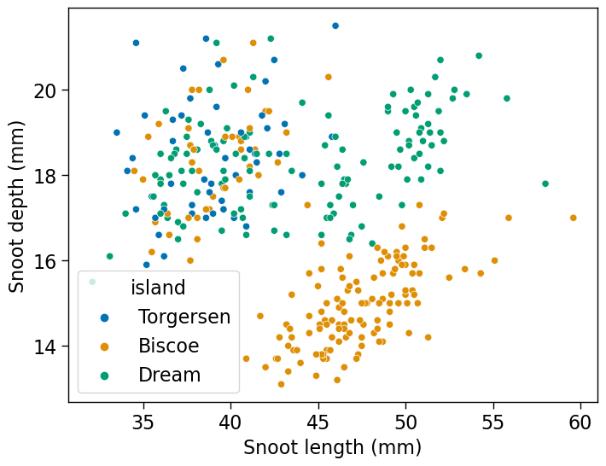
9. Colours: vary HUE to represent categories
Notes:
Difficult to read chart on the left
Penguins

Slide 21
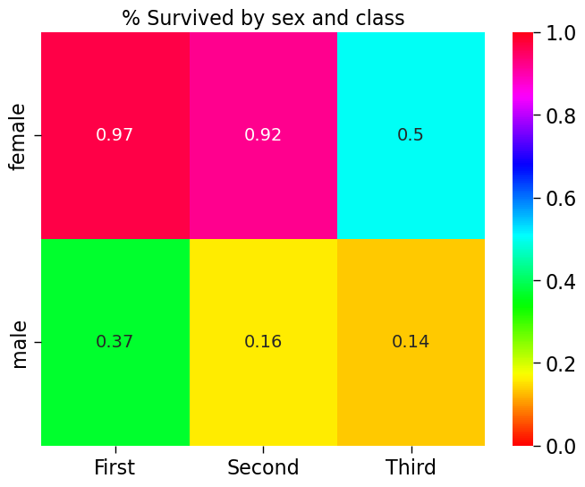
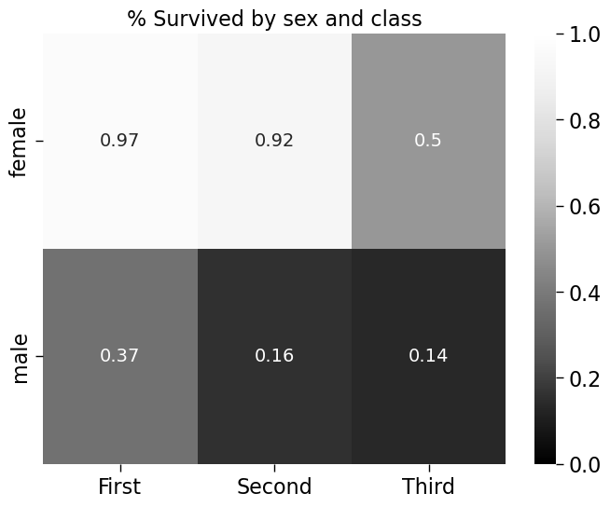
9. Colours: vary LUMINANCE to represent numbers

Slide 22
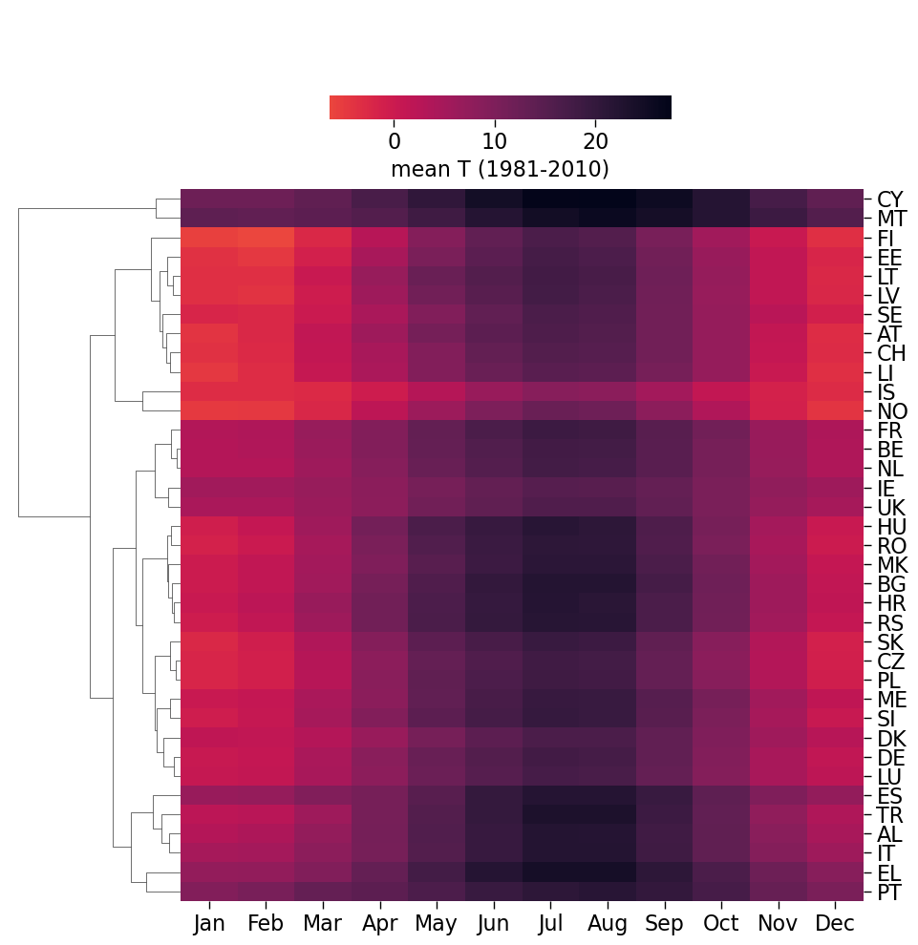
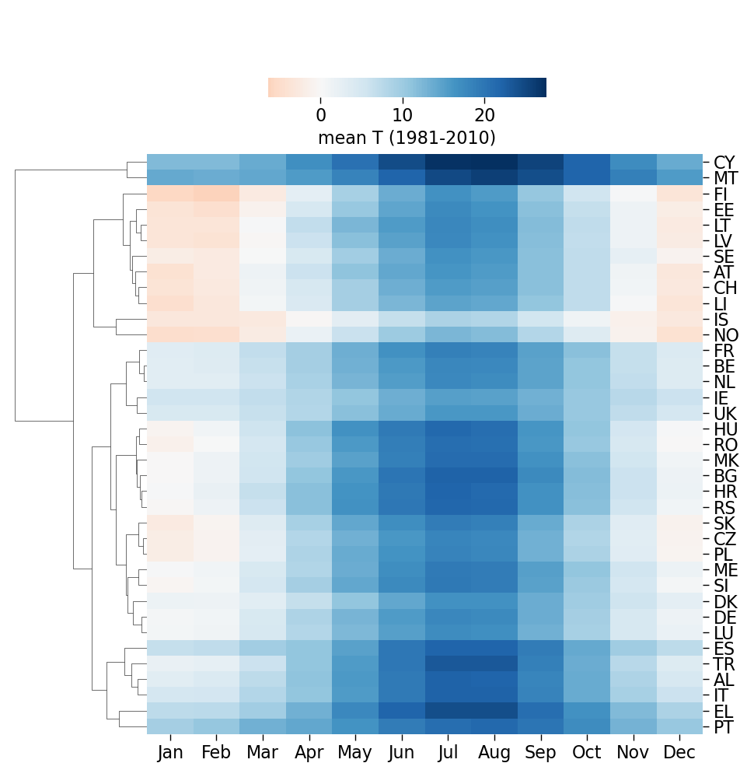
9. Colours: choose diverging palettes to emphasize low and high values
Notes:
Temp in Europe

Slide 23
9. Colours: there are palette-able solutions for all eyes
In R:
install.packages("viridis") # Good colour maps install.packages("RColorBrewer") # Good to design colour schemes
library(RColorBrewer)
##### Let’s create a new palette! #####
# Colorblind hex codes from Seaborn
colors <- c("#0173b2", "#de8f05", "#029e73", "#d55e00", "#cc78bc",
"#ca9161", "#fbafe4", "#949494", "#ece133", "#56b4e9")
# Create a custom palette
my_palette <- brewer.pal(n = length(colors), name = “colorblind")
# Replace the default colors with your specified colors
my_palette <- colors
# Display the palette
scales::show_col(my_palette)

Slide 24

10. Telling the truth is important (1)
“Stand Your Ground” reduced the number of deaths… or not??
The average temperature is not increasing… or not
Source: https://www.ncdc.noaa.gov/cag/
via https://climatereanalyzer.org/
Notes:
Misleading y axis., red zone why?

Slide 25
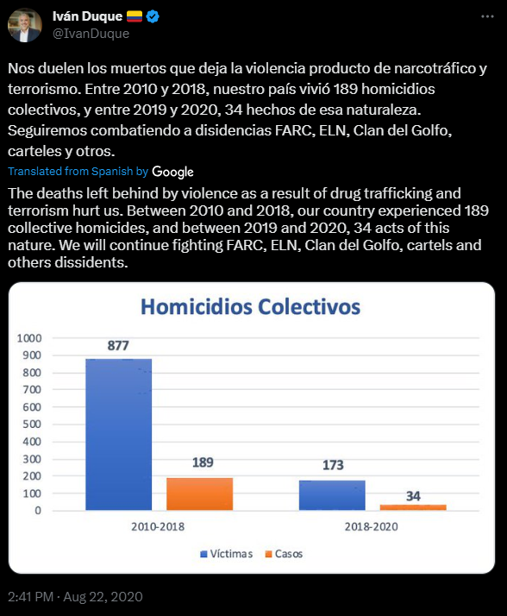
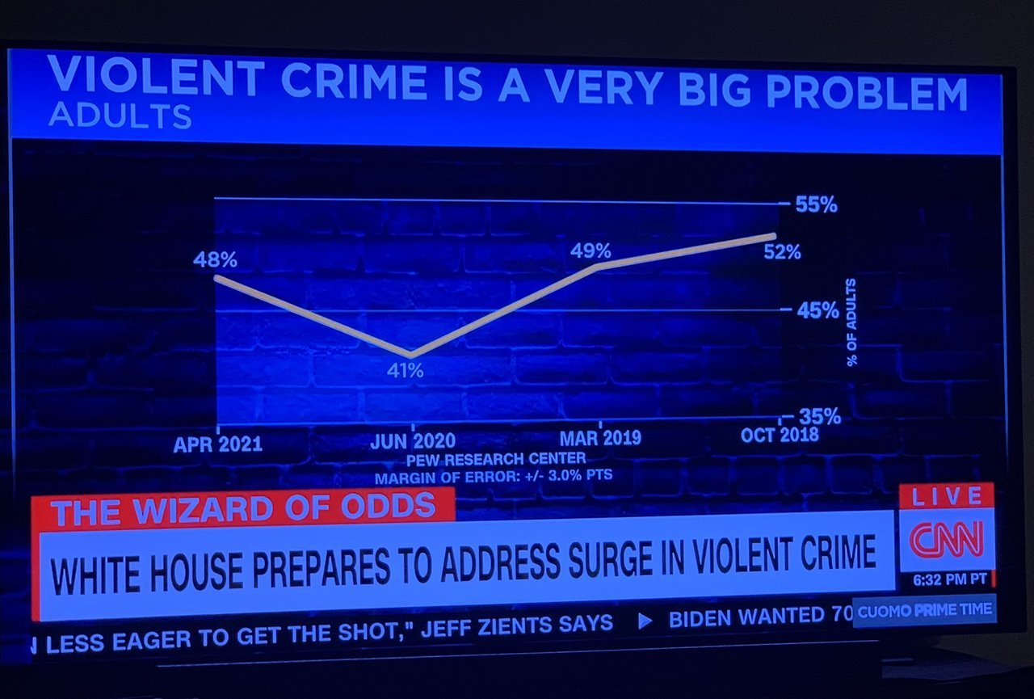
10. Telling the truth is important (2)
Credits to https://viz.wtf/
Source: https://twitter.com/IvanDuque/status/1297151862295199745
Notes:
x axis on the right wtf
X axis on left different number of years

Slide 26
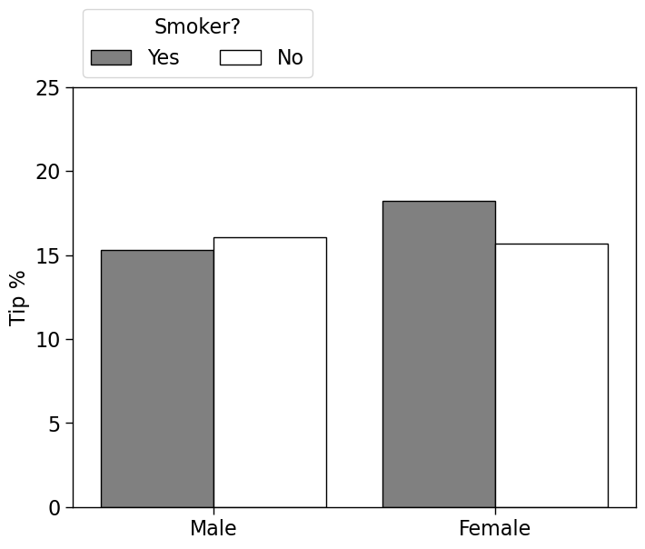
10.Telling the truth is important (3) Is there is uncertainty, show it!
Do women tip more than men?
Do smoker women tip more than non-smoker women?
Notes:
Quiz

Slide 27
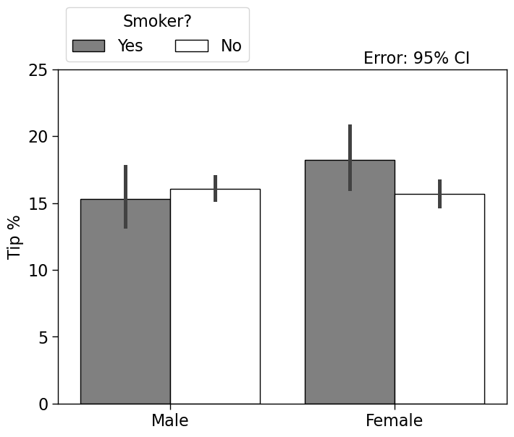
10. Telling the truth is important (3) Is there is uncertainty, show it!
t-test
p = 0.07
t-test
p = 0.25

Slide 28

Should you put caps at the end of error bars?
Think about the data-to-ink ratio…
Added information: 0
Notes:
No added info with Bars, do you really need them

Slide 29
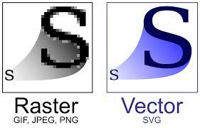
11. Choose a good image format
Raster graphics (.jpg, .png): photographs, digital art
Vector graphics (.pdf, .svg): graphs, plots, diagrams
Easily scalable without loss of quality

Slide 30
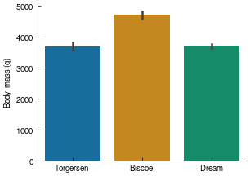
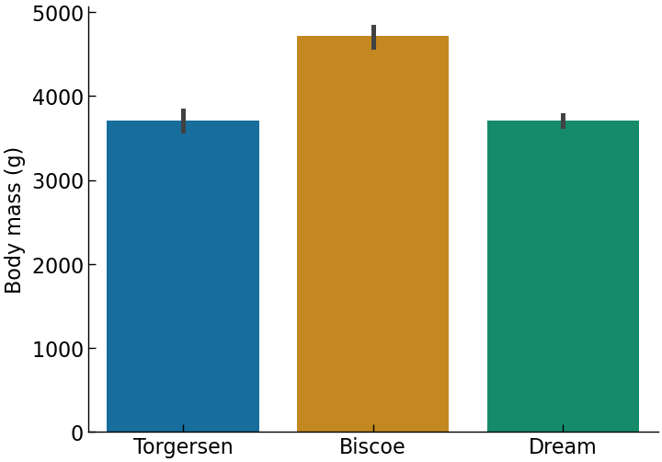
12. Change your plots depending on your output!
Small, concise plots are good for papers
(here: font 9)
Large plots with large font sizes are good for slides
(here: font 16)

Slide 31
Acknowledgements
Many of these slides were inspired by R. West’s “Applied Data Analysis” course at EPFL: https://docs.google.com/presentation/d/11eUfSrg84AWwnyl8sn3yMHKcGEm7JRc8-SCnhu9WImo/edit
Great course if you want to learn Python and learn more about data science methods!
And of course, by E. Tufte’s The Visual Display of Quantitative Information
Materials- https://ku-dviz.github.io/2024/materials/

